Slide 1
Concurrency

Slide 2
1. Introduction
concurrency : DBMSs typically allow many transactions to access the same database at the same time.
concurrency control mechanism : ensure that concurrent transactions do not interfere with each other.
Page <number>

Slide 3
2.Three Concurrency Problems
The lost update problem
(丢失修改)
The uncommitted dependency problem
(读“脏”数据问题)
The inconsistent analysis problem
(不可重复读问题)
Page <number>

Slide 4
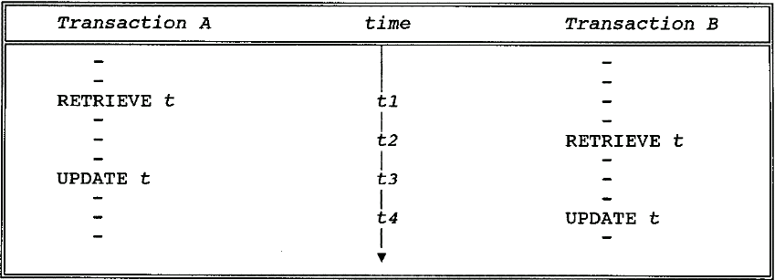
The Lost Update Problem
Transaction A's update is lost at time t4.
Page <number>
Notes:
读走了不存在的脏数据——没有提交函数依赖

Slide 5
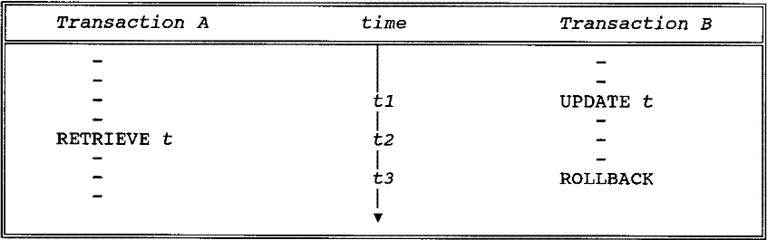
The Uncommitted Dependency Problem
The uncommitted dependency problem arises if one transaction is allowed to retrieve—or, worse, update—a tuple that has been updated by another transaction but not yet committed by that other transaction.
Page <number>

Slide 6
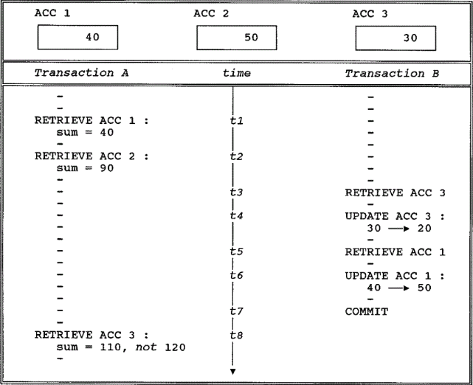
The Inconsistent Analysis Problem
Page <number>
Notes:
不可重复读问题

Slide 7
3. Locking (锁)
Two kinds of locks:
  Exclusive locks (X locks) / write locks 排它锁
  Shared locks (S locks) / read locks共享锁
If transaction A holds an exclusive (X) lock on tuple t, then a request from some distinct transaction B for a lock of either type on t will be denied.
If transaction A holds a shared (S) lock on tuple t, then:
  A request from some distinct transaction B for an X lock on t will be denied;
  A request from some distinct transaction B for an S lock on t will be granted (that is, B will now also hold an S lock on t).
Page <number>

Slide 8
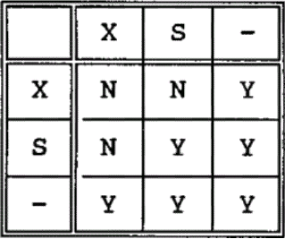
Lock type compatibility matrix
(锁相容矩阵)
Page <number>

Slide 9
Data access protocol / locking protocol
(封锁协议)
A transaction that wishes to retrieve a tuple must first acquire an S lock on that tuple.
A transaction that wishes to update a tuple must first acquire an X lock on that tuple.
  If it already holds an S lock on the tuple, then it must promote that S lock to X level.
Page <number>
Notes:
可以升级

Slide 10
Data access protocol / locking protocol…
If a lock request from transaction B is denied because it conflicts with a lock already held by transaction A, transaction B goes into a wait state. B will wait until A's lock is released.
  The system must guarantee that B does not wait forever.
  A simple way to provide such a guarantee is to service all lock requests on a "first-come, first-served" basis.
X locks are held until end-of-transaction (COMMIT or ROLLBACK). S locks are normally held until that time.
Page <number>
Notes:
确保B不会永远等下去，排队

Slide 11
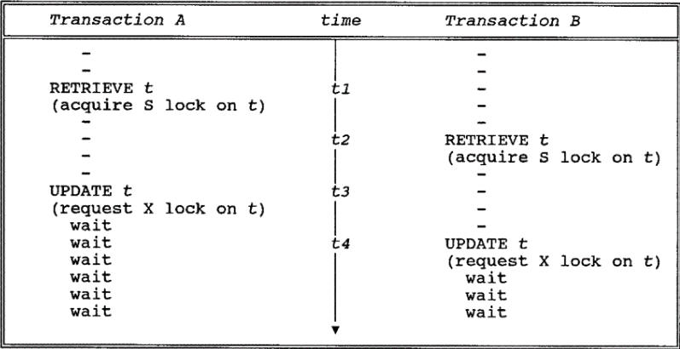
4. The Three Concurrency Problems Revisited
Locking solves the lost update problem.
Another problem: deadlock
Page <number>
Notes:
解决了丢失更新问题，但是出现新问题

Slide 12
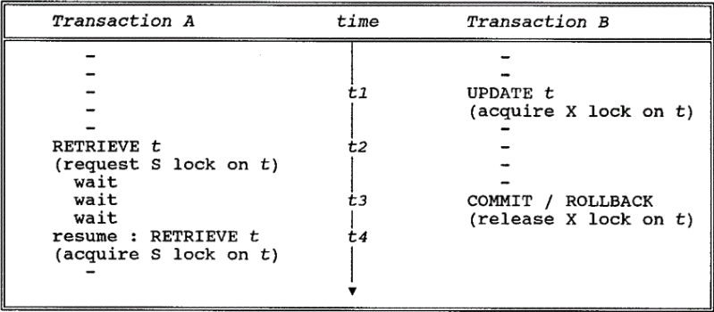
The Uncommitted Dependency Problem
Transaction A is prevented from seeing an uncommitted change at time t2.
Page <number>

Slide 13
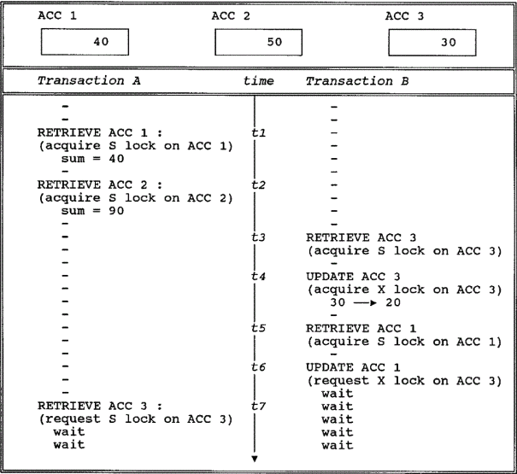
The Inconsistent Analysis Problem
Page <number>

Slide 14
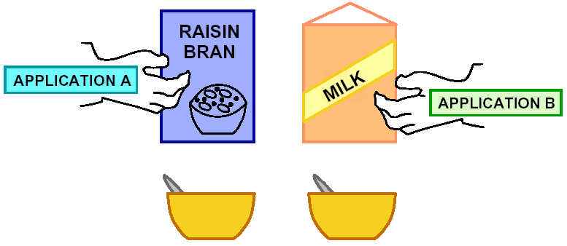
5. Deadlock
Page <number>

Slide 15
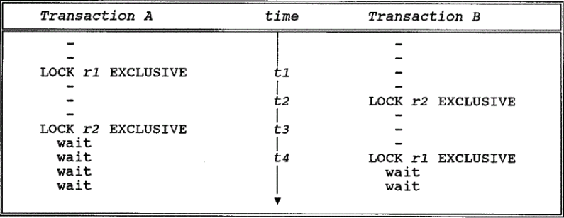
5. Deadlock …
Deadlock is a situation in which two or more transactions are in a simultaneous wait state, each of them waiting for one of the others to release a lock before it can proceed.
Page <number>

Slide 16
5. Deadlock …
If a deadlock occurs, it is desirable that the system detect it and break it.
Detecting the deadlock involves detecting a cycle in the Wait-For Graph.
Breaking the deadlock involves choosing one of the deadlocked transactions as the victim and rolling it back, thereby releasing its locks and so allowing some other transaction to proceed.
Page <number>
Notes:
超时/有环（选一个先不做，回滚）

Slide 17
6. Serializability(可串行性)
A given execution of a set of transactions is serializable(可串行化的), if it produces the same result as some serial execution of the same transactions, running them one at a time.
A given execution of a set of transactions is considered to be correct if it is serializable.
Page <number>
Notes:
实践中往往并行
交叉执行与串行的结果一致，正确

Slide 18
6. Serializability(可串行性)…
Individual transactions are assumed to be correct:
  transform a correct state of the database into another correct state.
Running the transactions one at a time in any serial order is correct:
  because individual transactions are assumed to be independent of one another.
An interleaved execution is correct if it is equivalent to some serial execution—i.e., if it is serializable.
Page <number>

Slide 19
6. Serializability(可串行性)…
Terminology:
  Given a set of transactions, any execution of those transactions, interleaved or otherwise, is called a schedule(调度).
  Executing the transactions one at a time, with no interleaving, constitutes a serial schedule(串行调度);
  A schedule that is not serial is an interleaved schedule并发调度 (or simply a nonserial schedule).
  Two schedules are said to be equivalent if they are guaranteed to produce the same result, independent of the initial state of the database.
Page <number>

Slide 20
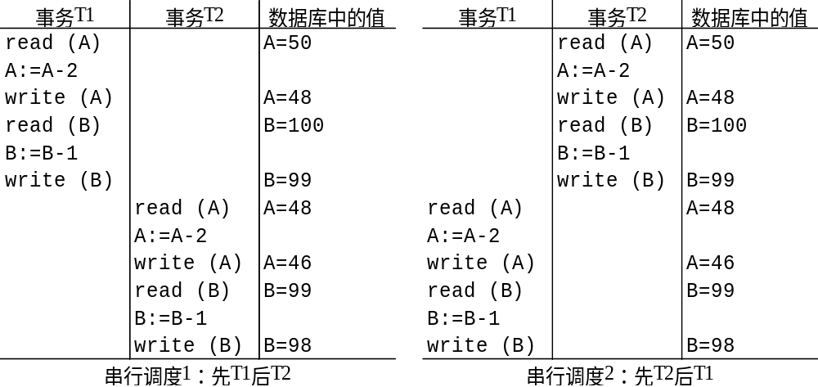
6. Serializability(可串行性)…
Page <number>

Slide 21
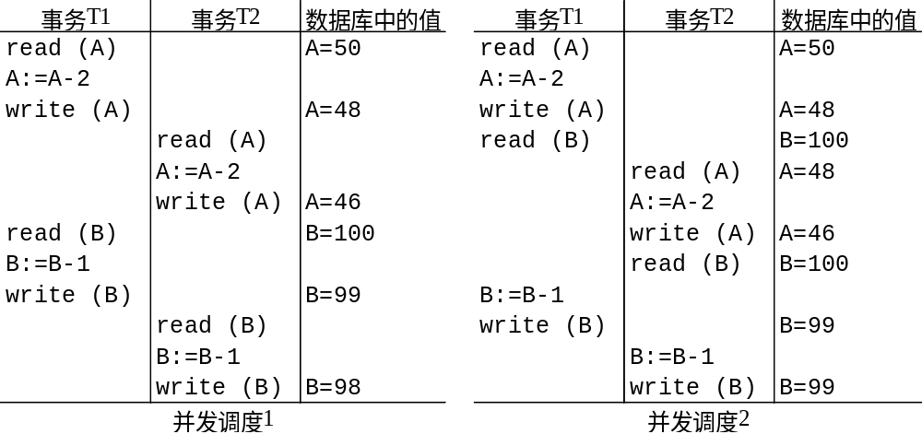
6. Serializability(可串行性)…
Page <number>

Slide 22
7. Two-phase locking protocol
If all transactions obey the "two-phase locking protocol," all possible interleaved schedules are serializable.
Two-phase locking protocol:
  Before operating on any object (e.g., a database tuple), a transaction must acquire a lock on that object;
  After releasing a lock, a transaction must never go on to acquire any more locks.
Page <number>

Slide 23
7. Two-phase locking protocol…
T1:
Slock(A)、Slock(B)、Xlock(C)、Unlock(A)、Unlock(B)、Unlock(C)
obey the two-phase locking protocol
T2: Xlock(B)、Unlock(B)
obey the two-phase locking protocol
T3:
Slock(A)、Slock(B)、Unlock(B)、Xlock(C)、
Unlock(A)、Unlock(C)
not obey the two-phase locking protocol
Page <number>

